Slide 1

filesorterU
PASS
CS532: OS Foundations
Lab Assignment (updated)
email address: parth2@pdx.edu
partner’s email address:

Slide 2
Instructions: Make a copy of this document, move your copy to your submissions folder and fill the document with your responses. Use the space on each slide to show your responses, and add additional slides as needed.
When ready for grading: complete the lab assignment submission form and include a link to your filled document
Note: this is an updated version of the original filesorter lab assignment. You are free to do either or both of the assignments to receive credit for either or both of them.

Slide 3
filesorterU -- sort binary files
Write a new program, filesorterU.c that accepts one command line parameter (D = location of directory containing unsorted binary integer files)
The program should exit with an error if D does not exist. It should read each unsorted_<id>.bin file in D, sort the integers found in the file and write the sorted integers to a new file <D>/sorted/sorted_<id>.bin
The program should not assume that the sub-directory is already created and should create the <D>/sorted sub-directory if needed.
Use any sorting algorithm you like, but you must code the sort yourself. You are not allowed to use qsort() or any other library function for sorting.
HINT: write a simple sort. Sort speed likely will not limit the speed of your program.

Slide 4
as with the previous assignment, use open(), close(), read(), write(). do not use fopen(), fclose(), fread(), fwrite(), or related functionality.
Use your previously created filecreator program to create various sets of unsorted files and then use filesorterU to sort them. I plan to test your program with inputs such as these:
./filecreator <name of directory> 10 10 2
./filesorterU <name of directory>
./filecreator <name of directory> 1000 10000 5
./filesorterU <name of directory>

Slide 5
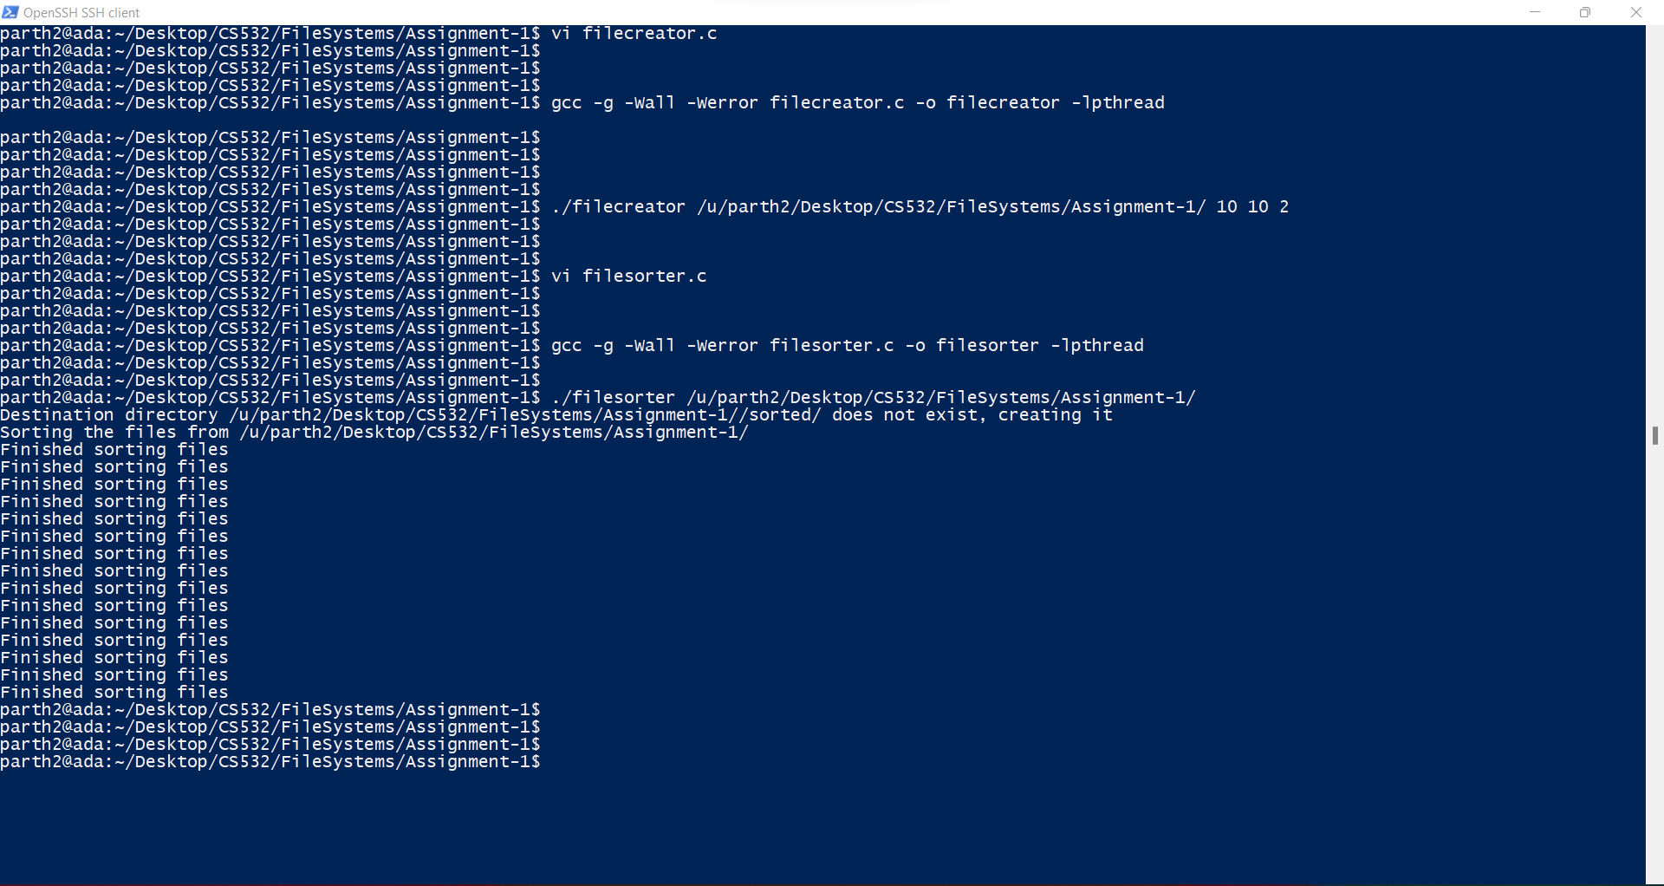

Slide 6
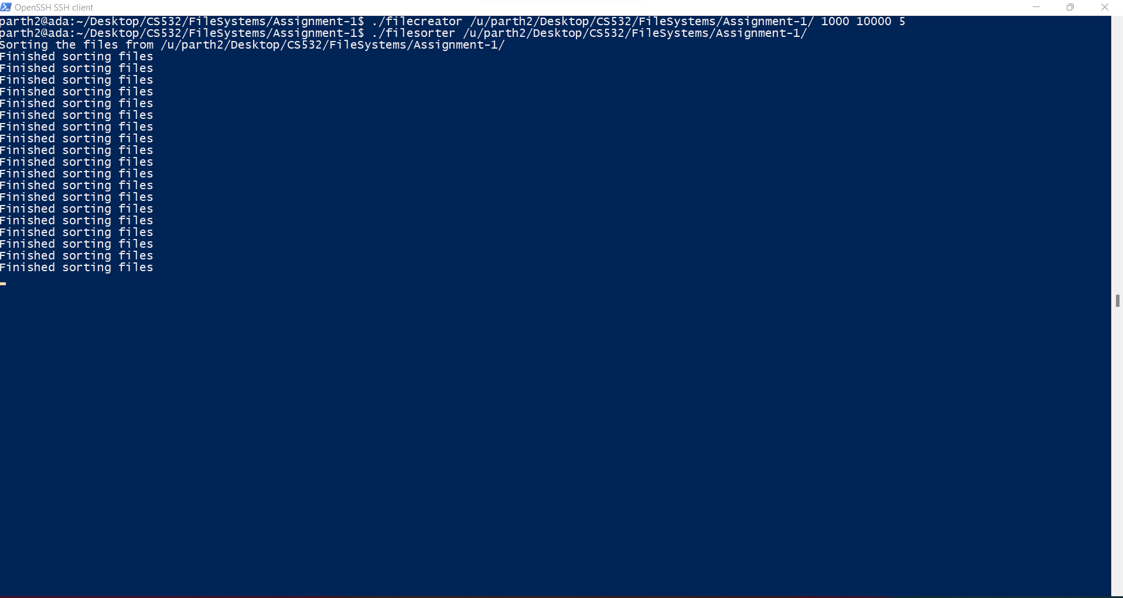

Slide 7
I also plan to test negative cases to make sure that you gain experience with proper use of the essential persistence-related Linux system calls:
No input parameter to program
Input a directory that does not exist
Input a directory that contains no unsorted_<id>.bin files
Input a directory that contains unsorted_<id>.bin files that cannot be read
Input a directory that already has a sorted sub-directory
Input a directory that has a sorted sub-directory that is read-only
Input a directory that contains a sorted sub-directory that contains read-only sorted_<>.bin files
So you should test these cases as well. Your filesorterU must correctly catch these cases, emit a suitable error message to stderr and exit with a -1 or other suitable (non-zero) return value.
NOTE: to “emit a suitable error message to stderr” use fprintf(stderr, <message>, <params>);

Slide 8
1. What sorting algorithm did you implement and why?
Qsort because it is faster.
?? The code does not implement qsort.

Slide 9
3. Copy your filesorterU.c program to your submissions folder and provide a link to it here: <link>
https://drive.google.com/file/d/1UQ_wfaFaSEwINvgkjbItNN8wkgP35wAb/view?usp=sharing
Tests all pass. Nice work!

